Slide 1
Automated Attendance System
Using Machine Learning

Slide 2
Timeline:
Week 1
Week 2
Week 3
Week 4
Face and Eye detection using openCV
Use of face_recognition library using python
Create database using MySQL with proper datatypes
Store the face encodings in database
Week 5
Week 6
Week 7
Design front end and interactive dashboard for users
Build functionality to take and store attendance
Debugging and new features

Slide 3
Last 2 weeks!
Database
Basic front end
*Database
*Face encodings
*User and Admin login
*Interactive dashboard
Week 03
Week 04
Created database and stored face encodings as BLOB files
Created interactive front end for users

Slide 4
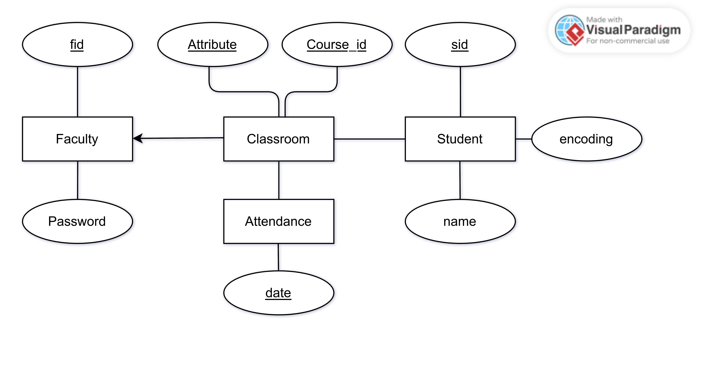
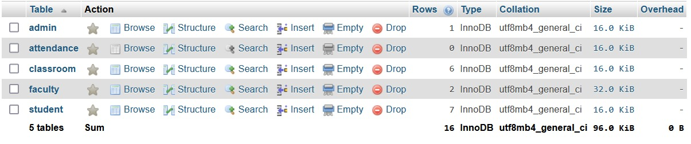
Week 03

Slide 5
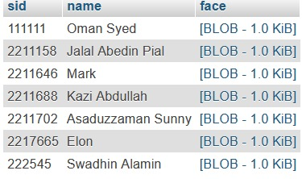
Storing Face Encoding

Slide 6
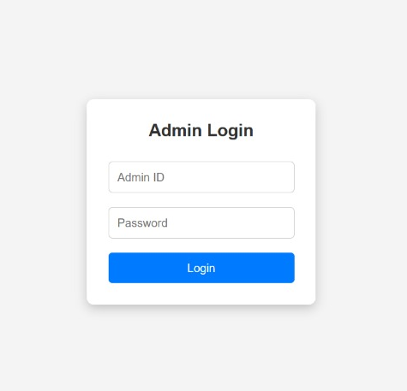
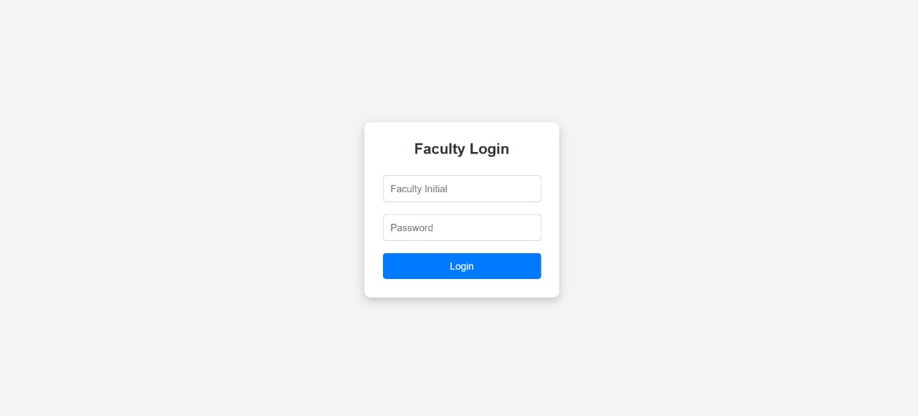
Week 04

Slide 7
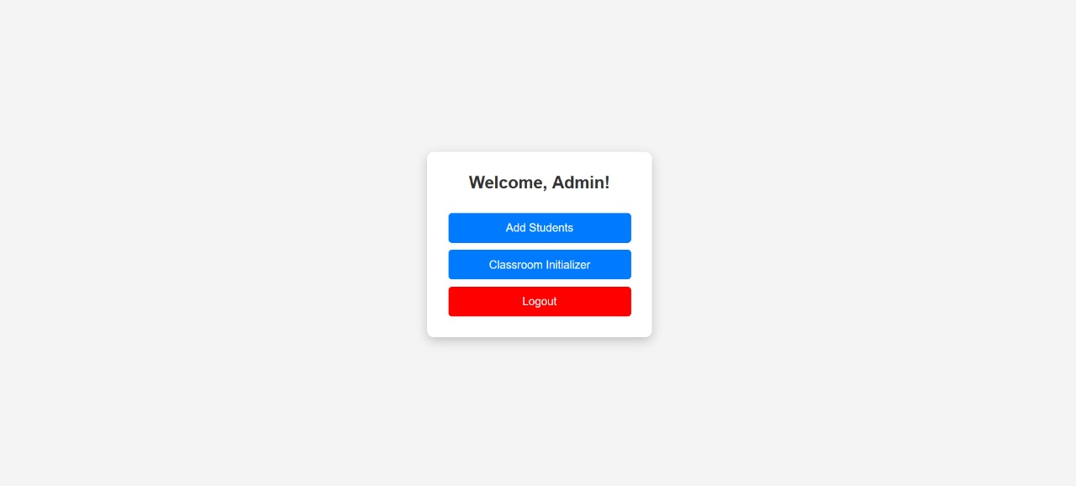

Slide 8


Slide 9
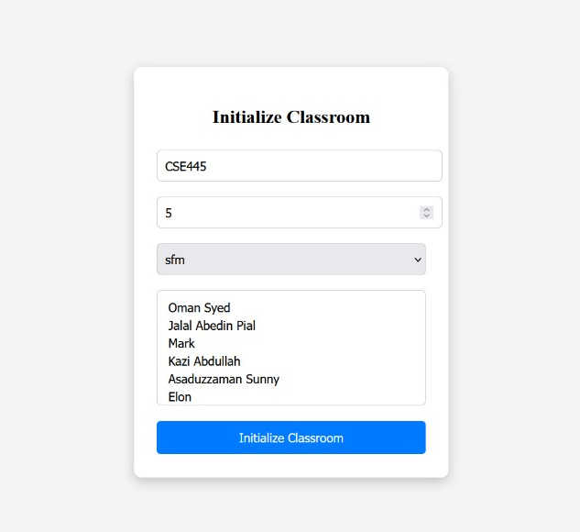
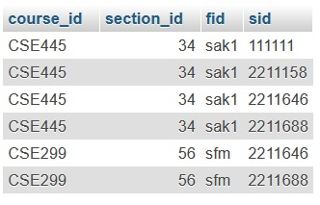

Slide 10
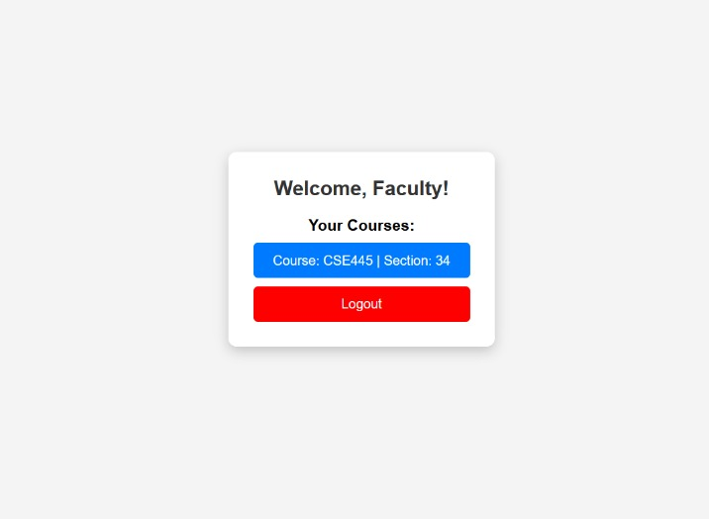

Slide 11
Faculty Dashboard Plan
Select Any Course
he/she teaching
Run python script to take attendance
Attendance History
Manual Attendance

Slide 12
Issues faced:
01
04
What previledges should admin and faculties have over database?
Required Data fields?
What is datatype that we need?
02
Issues
05
Redundant Data
How to store connect php and python?
03
06
Storing Attendance

Slide 13
Next 2 weeks plan:
01
Build Functionality
Store attendance into the database
Next 2 weeks plans
02
Small functional works
Manual Attendance, other small features

Slide 14
Thank You!

